Slide 1

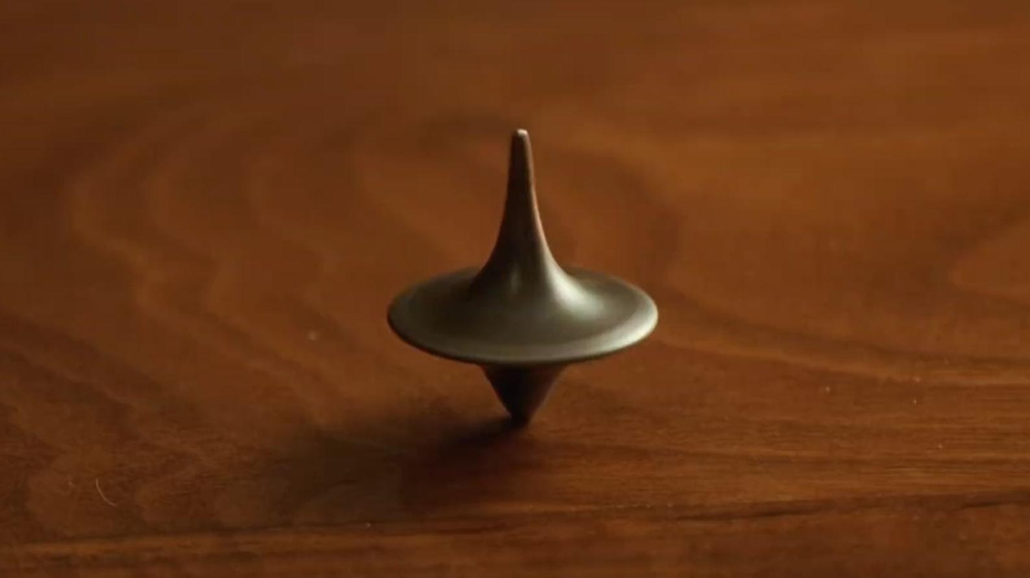
The Dream Decoder
吴宇轩2330034057
杨宇皓2330031324
陈傲然2430031009
宋浩源2230026136
李颐恬2330026085

Slide 2
Context
1
Introduction
2
Motivation
3
Achievement
4
Future

Slide 3
Part I
Introduction

Slide 4

Introduction
Have you ever dream?
Many traditional approaches
What if: new, data driven system?
A Dreamcatcher

Slide 5
Part Ⅱ
Motivation

Slide 6
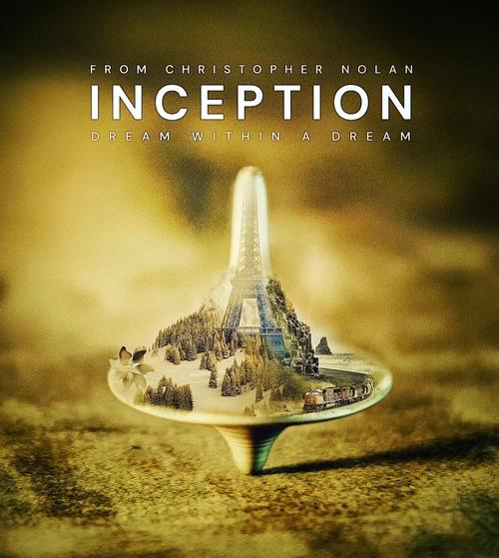
Motivation
A thrilling collision of two opposites
Subconsciousness & embedding model
Making intangible tangible
Construct a semantic map

Slide 7
HEY
WAKE UP!
VITO
RAY
Part Ⅲ
DESIGNED BY IBOTU
Achievement
DESIGNED BY IBOTU
DO SOME
THINGS!

Slide 8
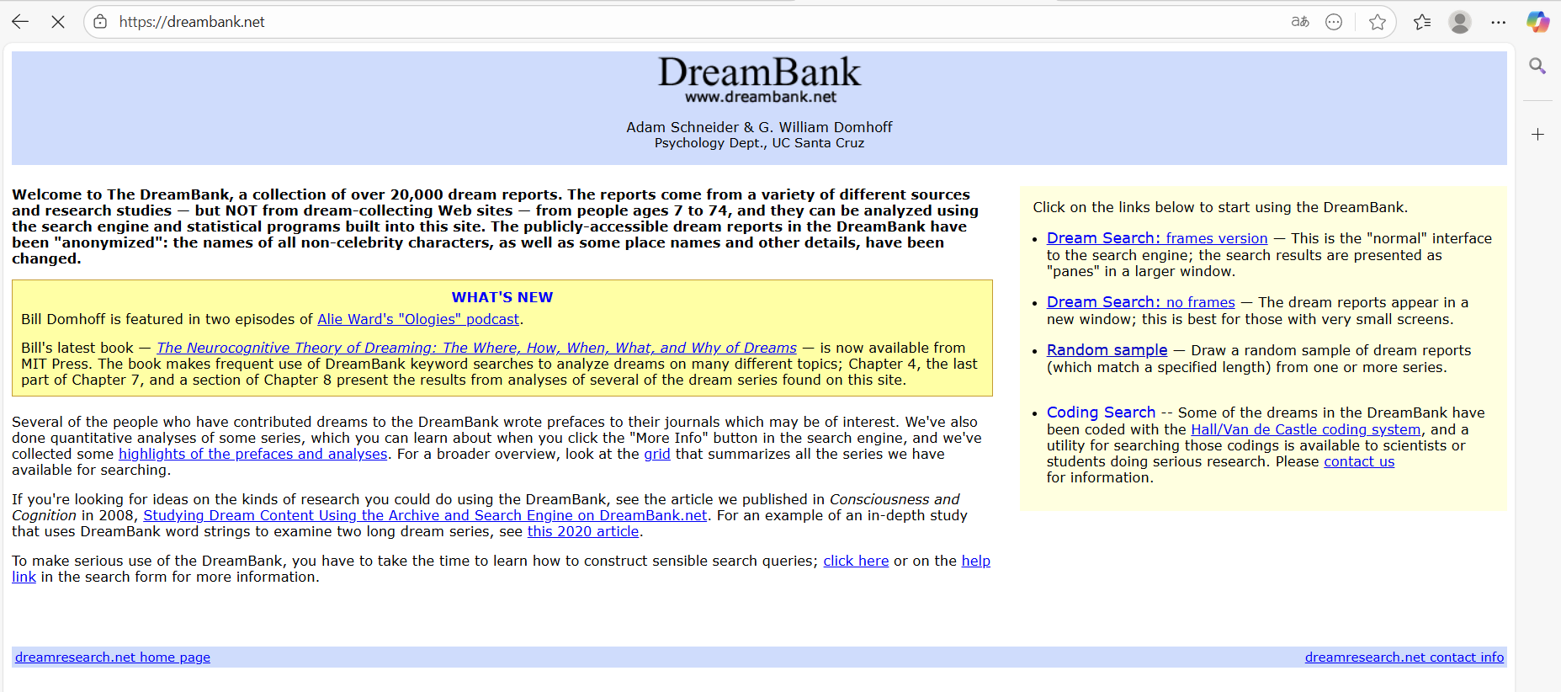
Achievement
Sources: Dreambank
Engine: Embedding model
Dreams with similar meanings→Resembal
mathematically vectors

Slide 9
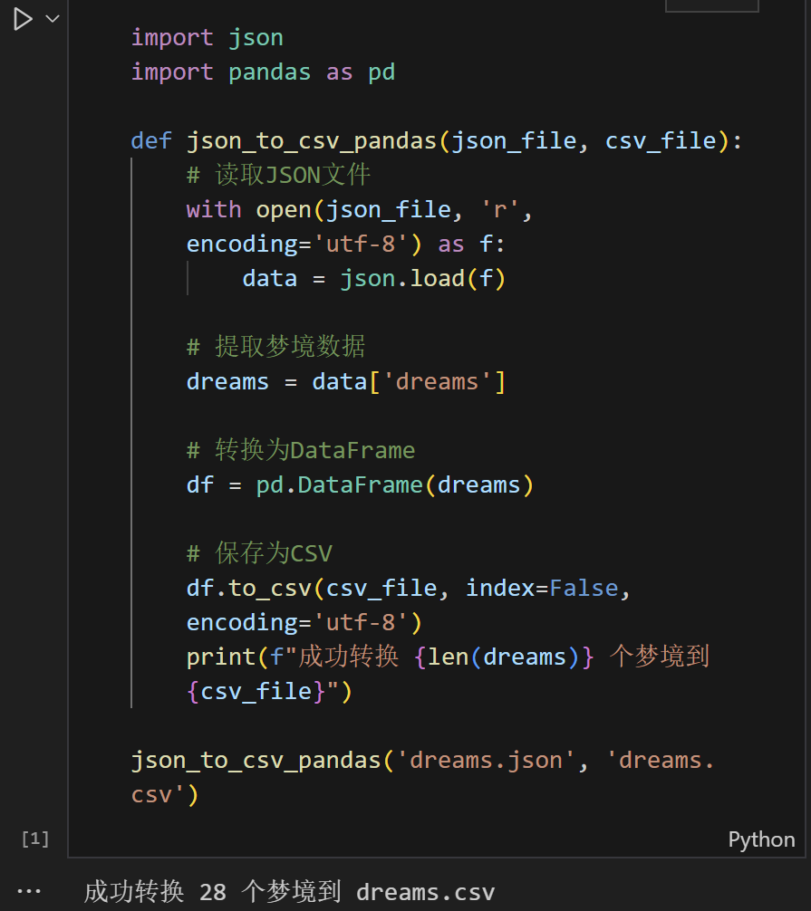
Achievement
Raw dreams’ text
JSON file
CSV file（INPUT）
regular expressions,
pd.Dataframe
(JSON --> CSV Program)

Slide 10

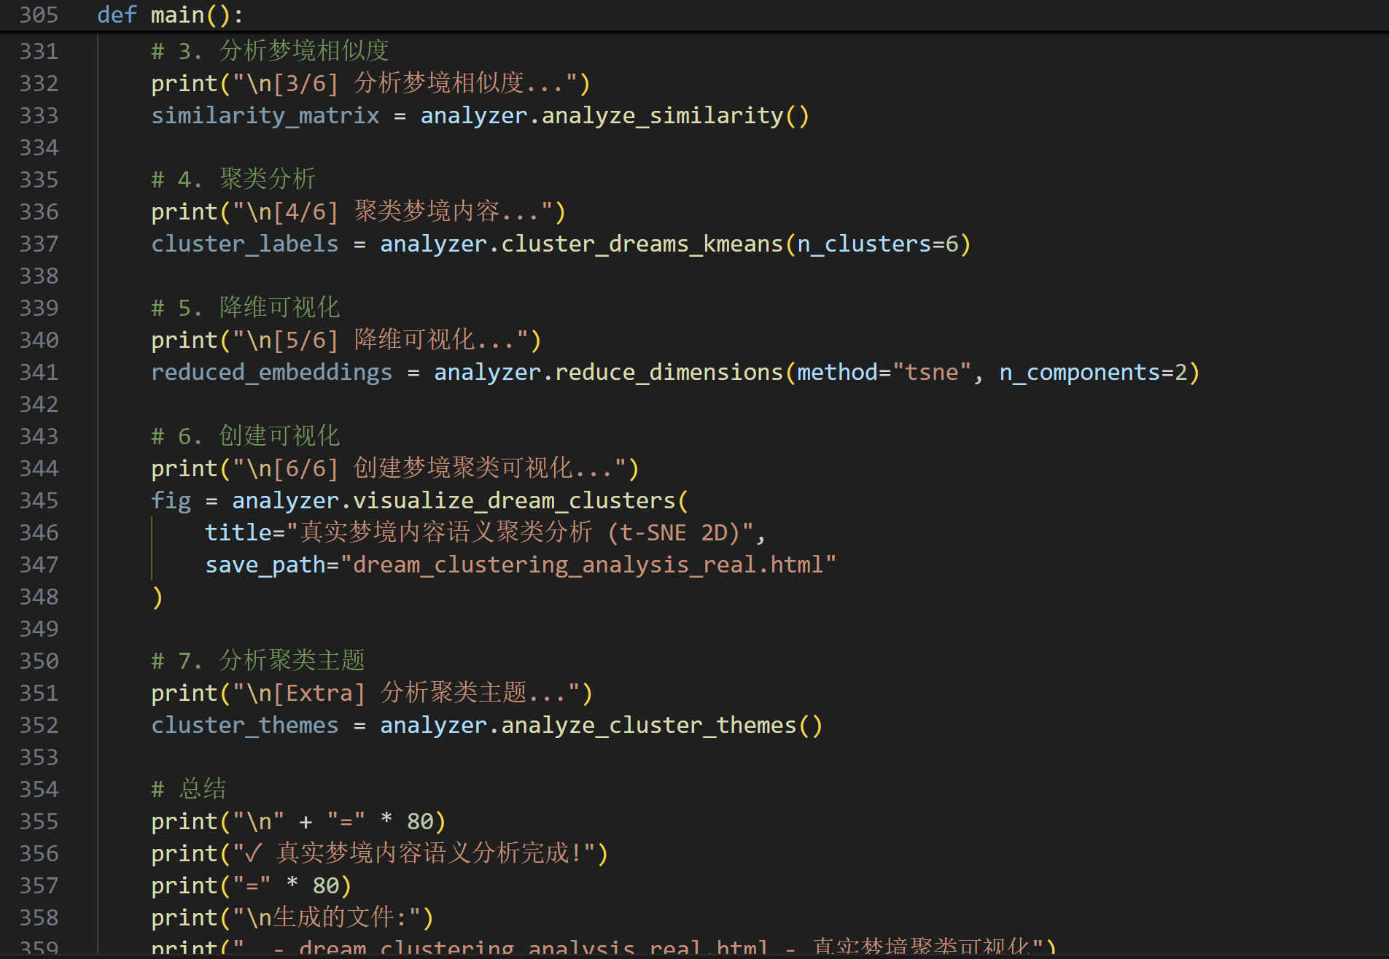
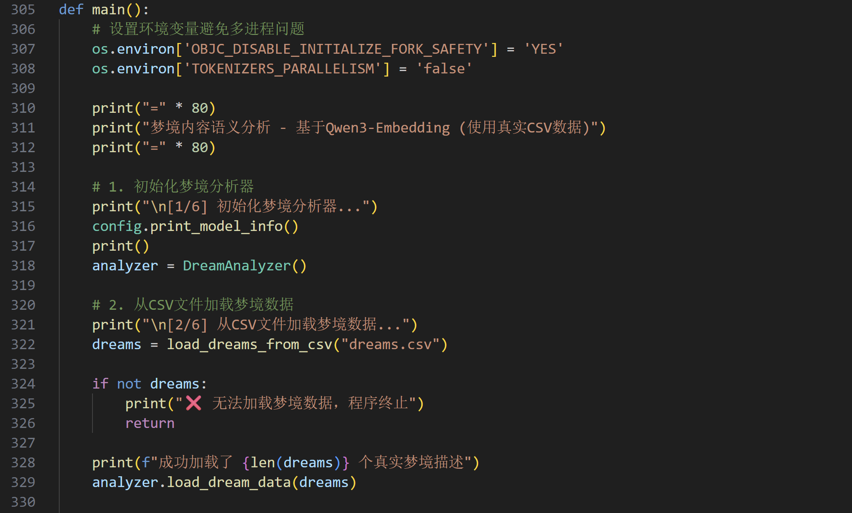
Achievement
Qwen3-Embedding-4B model Cosine Similarity
K-Means clustering t-SNE for dimensionality reduction

Slide 11
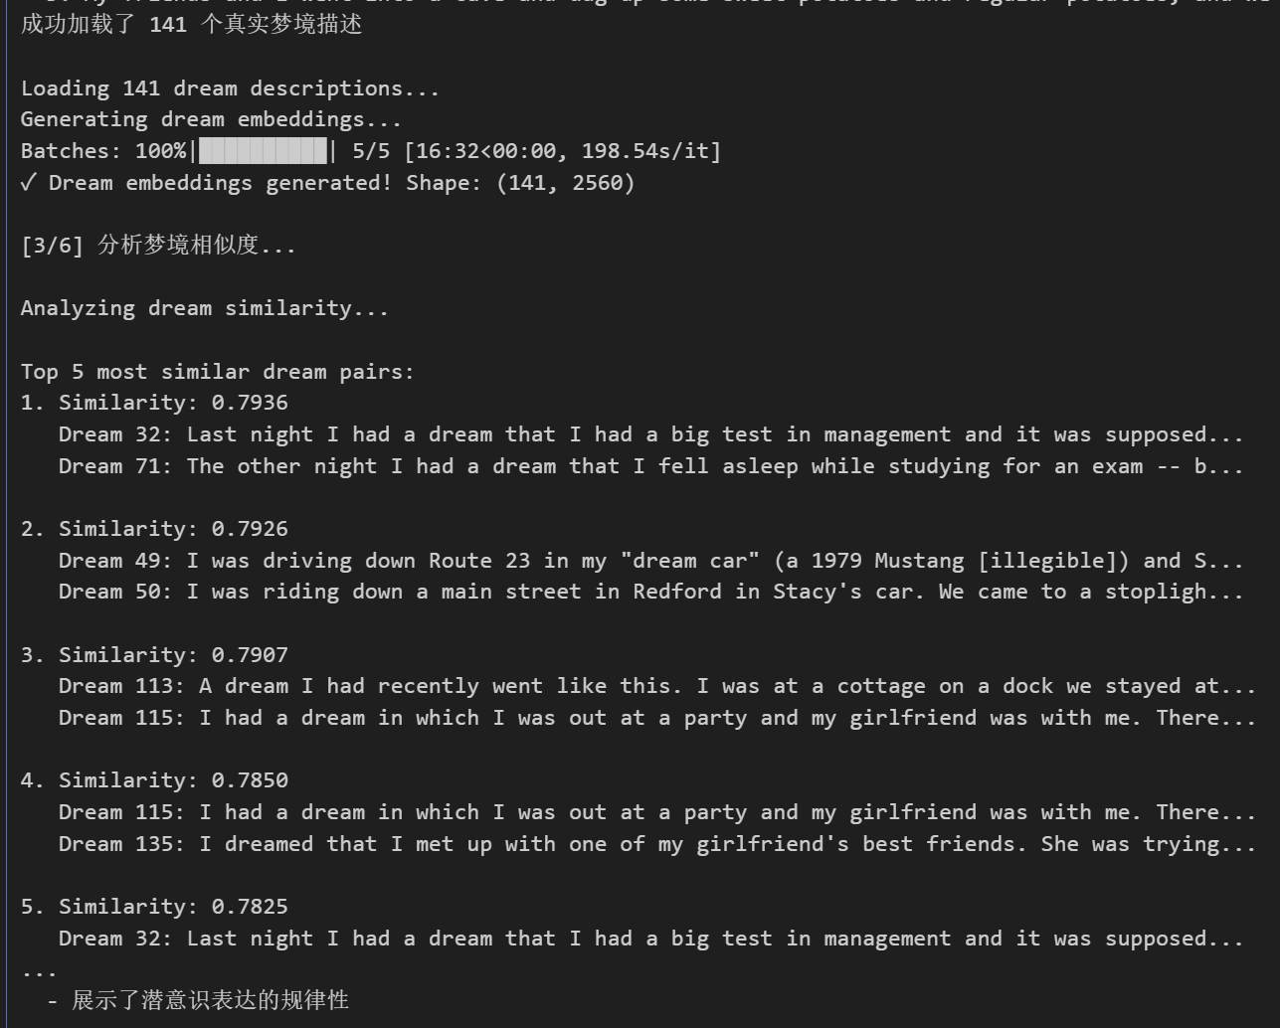
Achievement
An interactive 2D visualization
（Running Result in Interactive windows）

Slide 12
HEY
WAKE UP!
VITO
RAY
Part Ⅳ
DESIGNED BY IBOTU
Future
DESIGNED BY IBOTU
DO SOME
THINGS!

Slide 13
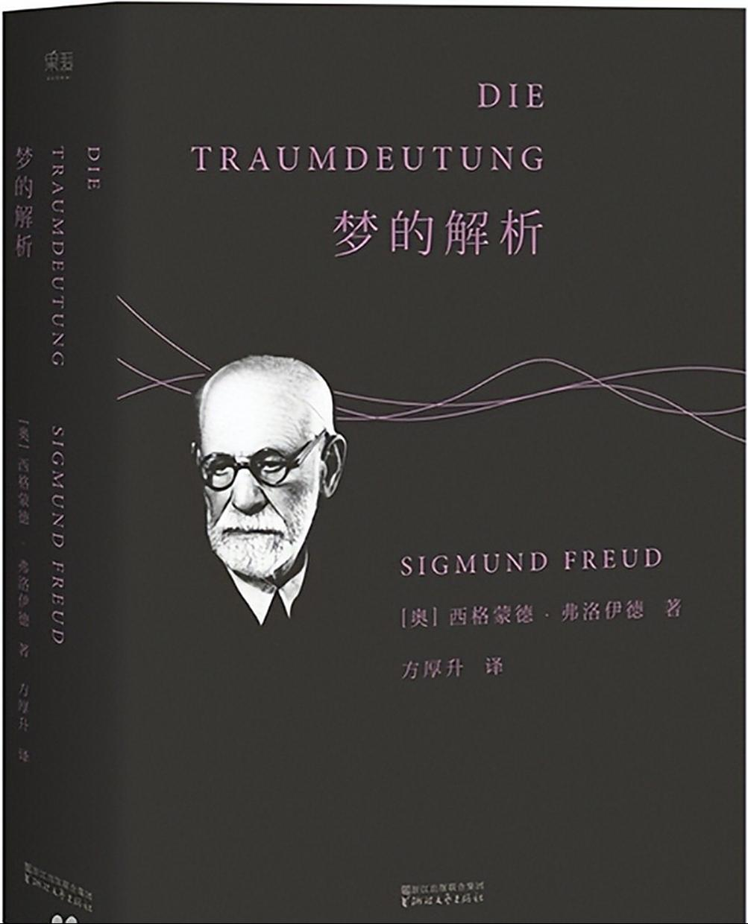
Future
Create a visual semantic map
Enrich clusters with psychological dimensions
Dream decoding

Slide 14
THANKS

